Slide 1


E-Waste Management
“Globally, an estimated 50 million tons of
E-waste is produced annually”

Slide 2
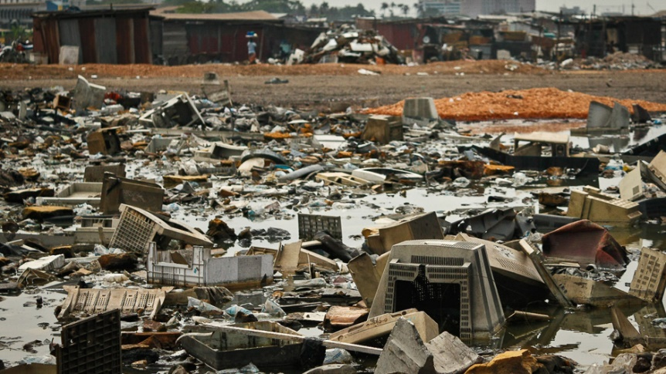
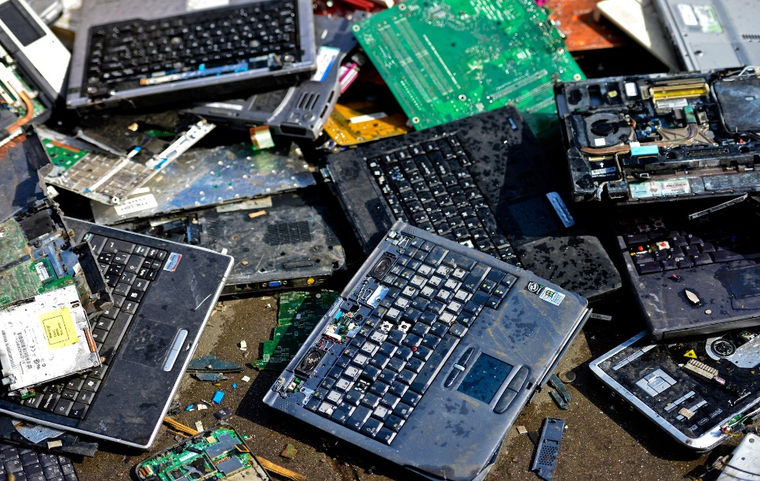
What is E-Waste?
"Electronic waste" or "E-Waste" may be defined as discarded computers, office electronic equipment, entertainment device electronics, mobile phones, television sets, and refrigerators. This includes used electronics which are destined for reuse, resale, salvage, recycling, or disposal. Others are re-usable (working and repairable electronics) and secondary scrap (copper, steel, plastic, etc.) to be "commodities", and reserve the term "waste" for residue or material which is dumped by the buyer rather than recycled, including residue from reuse and recycling operations, because loads of surplus electronics are frequently commingled (good, recyclable, and non-recyclable), several public policy advocates apply the term "e-waste" broadly to all surplus electronics.

Slide 3
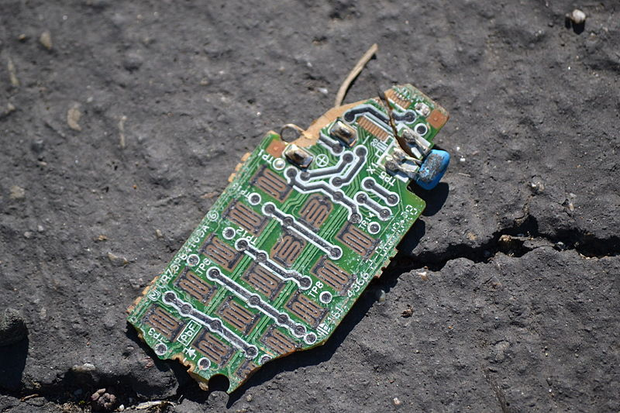
Amount of E-waste Worldwide
An estimated 50 million tons of E-waste are produced each year. The USA discards 30 million computers each year and 100 million phones are disposed of in Europe each year. The Environmental Protection Agency estimates that only 15–20% of e-waste is recycled, the rest of these electronics go directly into landfills and incinerators.

Slide 4

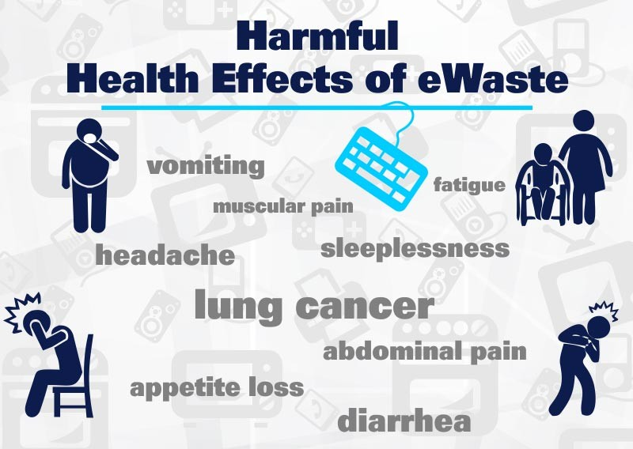
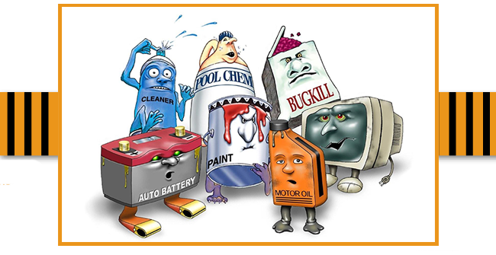
Effects of E-waste on Environment-

Slide 5
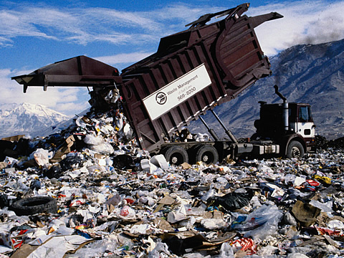
1. Improper Electronic Waste Disposal leads to negative effects of E-waste on Environment
Computers contain toxic materials like zinc, nickel, lead, barium and chromium, which is why it’s critical to do proper computer recycling.
Each of these metals occur in concentrations that are higher than the federally regulated levels. Our growing stream of e-waste is a threat to our environment.

Slide 6
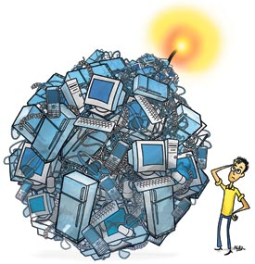
2. Effects of E-waste on Environment through Landfills
When we throw out our computers, they wind up in landfills, causing the possibility of toxic metal leaching into the groundwater. Toxic metals in e-waste leach into our supply of resources, threatening their integrity.
When e-waste is warmed up, toxic chemicals are released in to the air, damaging the atmosphere. E-waste management is a critical consideration for future generations as proper electronic recycling is becoming harder to find.

Slide 7
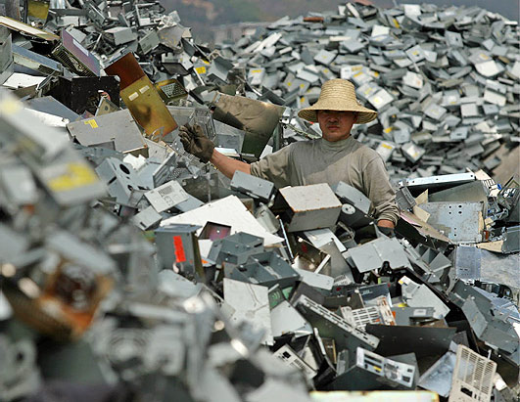
3. Effects of E-waste on Environments in Third World Countries
E-waste adversely affects our developing nations. Instead of responsibly recycling our electronic devices, America sends our e-waste to these countries. The e-waste piles up in the landfills, which cause harm to the environment in various ways. Toxins from the metals in electronics are released in to the atmosphere, and what is worse, when e-waste disposal is not subsidized, the pollutants from our electronic waste can end up in toys for our children that are sent back to us.
Instead of exporting e-waste, or letting it rot in landfills, we can help our environment by returning our electrical products to stores and manufacturers, sending them to responsible recycling centers, selling them to people that will find them useful, or donating them to stores such as Goodwill donation center.

Slide 8



Information Security
E-waste presents a potential security threat to individuals and exporting countries. Hard drives that are not properly erased before the computer is disposed of can be reopened, exposing sensitive information. Credit card numbers, private financial data, account information, and records of online transactions can be accessed by most willing individuals.

Slide 9


Thank You
Efforts By:- UTKARSH DUBEY
(VII-A)

